Slide 1
Introduction to .NET
Florin Olariu
“Alexandru Ioan Cuza”, University of Iași
Department of Computer Science

Slide 2
Agenda
CQRS
Domain events - DDD
Event Sourcing
DEMO

Slide 3
CQRS
Notes:
Stands: Command Query Responsibility Segregation

Slide 4
CQRS
Wikipedia : Command Query Responsibility Segregation (CQRS) applies the CQS principle by using separate Query and Command objects to retrieve and modify data, respectively.
Notes:
Stands: Command Query Responsibility Segregation

Slide 5
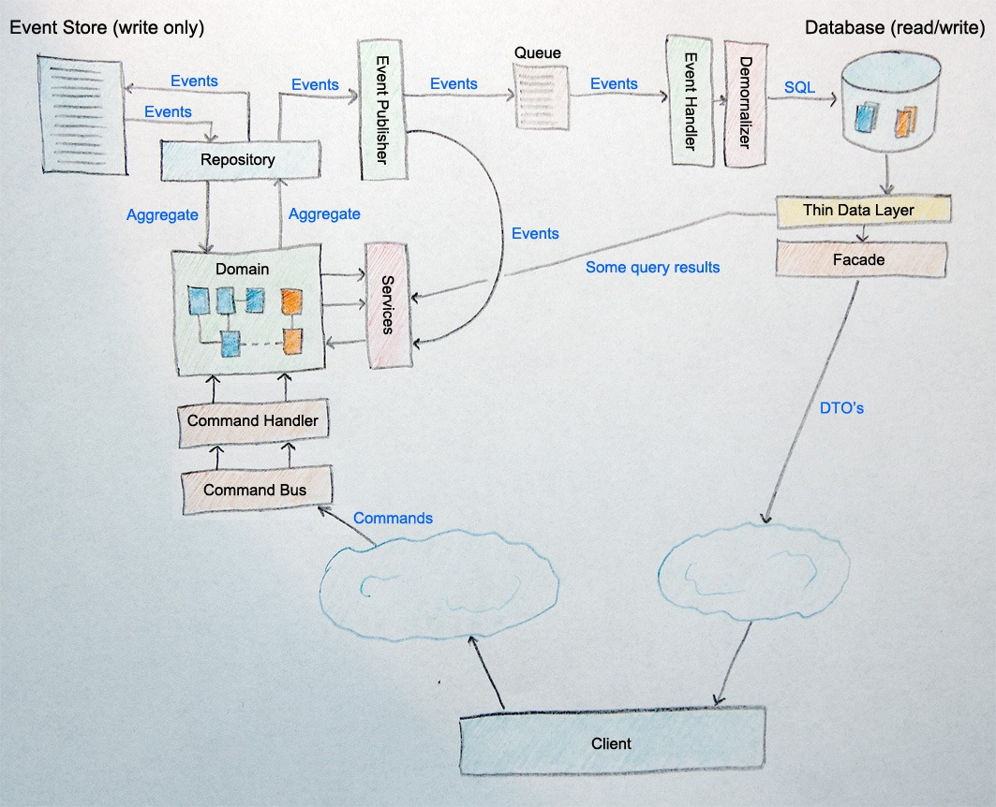
CQRS

Slide 6
Domain events - DDD

Slide 7
Domain events - DDD
“Domain events is a preferred way to trigger side effects across multiple aggregates within the same domain”

Slide 8
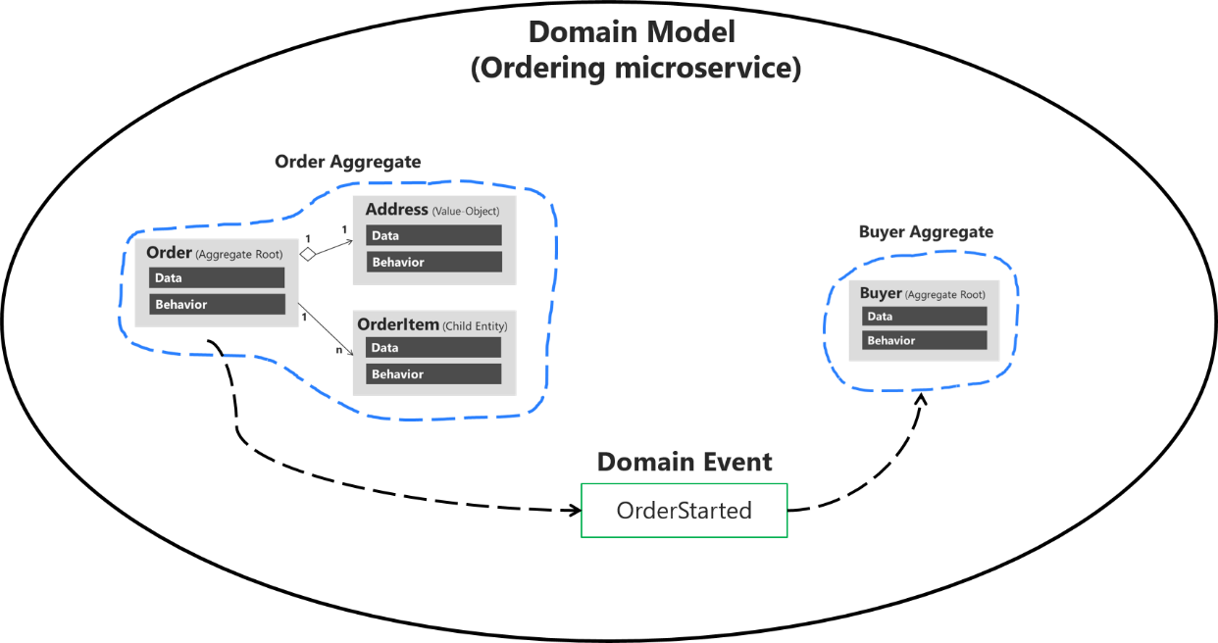
Domain events - DDD
“Domain events is a preferred way to trigger side effects across multiple aggregates within the same domain”

Slide 9
Domain events - DDD
http://www.tonytruong.net/domain-events-pattern-example/
https://www.infoq.com/news/2015/09/domain-events-consistency

Slide 10
Event Sourcing

Slide 11
Event Sourcing
“Event Sourcing ensures that all changes to application state are stored as a sequence of events.” – Martin Fowler - Event Sourcing 2005
Notes:
The fundamental idea of Event Sourcing is that of ensuring every change to the state of an application is captured in an event object, and that these event objects are themselves stored in the sequence they were applied for the same lifetime as the application state itself.

Slide 12
DEMO
Full architecture - separation concerns, SOLID and Clean Code Domain Driven Design - layers Domain Events Domain Notification CQRS (Immediate Consistency) Event Sourcing Unit of Work

Slide 13
One more thing…

Slide 14
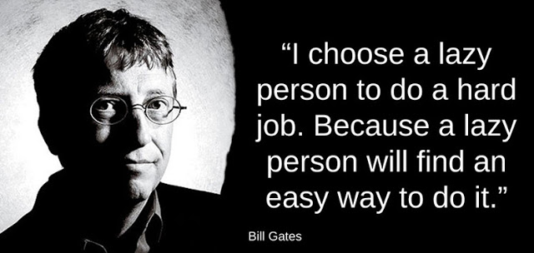
One more thing…

Slide 15
Bibliography
Pluralsight
https://docs.microsoft.com/en-us/dotnet/standard/microservices-architecture/microservice-ddd-cqrs-patterns/domain-events-design-implementation
https://martinfowler.com/eaaDev/EventSourcing.html
Martin Fowler: Microservices – This article is robust, but, at the same time, not too wordy. It provides a great overview of Microservices
Microservices.io –this site is aimed at documenting all of the various patterns that we use to architect Microservices.
Building Microservices by Sam Newman – A really good book on the topic.

Slide 16
Questions
Do you have any other questions?

Slide 17
Thanks!
See you next time! ☺

